Slide 1
Collin College (Dual Credit) Clinical Programs
Presenters:
Josh Snyder, MBA, CCT-P
Health Professions, Program Coordinator
Dr. Juli Westcott, DC, ATC, LAT, EMT
Health Professions, Program Director

Slide 2
Which Clinical Course is right for ME??
Prosper ISD Dual Credit Health Sciences

Slide 3
CNA (Certified Nursing Aide)
Who can take it and what are the prerequisites?
11th and 12th grade students
Principles of Health Science (required)
What will I learn?
Fall: Skills for the care of geriatric clients (NURA 1301)
End of Life studies (HPRS 1303)
Spring: Hands-on training at a nursing home (NURA 1160)
Basic Health Profession Skills II (HPRS 2310)
Where will my clinical rotations be?
Nursing homes, assisted living, and memory care facilities (or simulated in lab if COVID restrictions remain in place)

Slide 4
C.N.A. (Certified Nursing Aide)
Which certification can I earn?
Students who successfully complete state testing will receive their Certified Nursing Assistant (C.N.A.) credential.
Where can I work?
C.N.A.’s can work at nursing homes, home health agencies, and long-term care facilities, as well as many hospitals.
*Please note: Mandatory class hours are required for this program. Minimal absences will be allowed for students completing this program.

Slide 5
Estimated C.N.A. Program Cost
Tuition* and Fees | $620.00
Textbook | $140.00
Scrubs | $40.00
Immunization Tracker | $30.00
Drug Testing/ Background Check | $72.00
Lab Fee | $24.00
Liability Insurance | $11.00
Certification Exam | $125.00
Total = $1,062

Slide 6
E.K.G. Technician
Who can take it and what are the prerequisites?
11th or 12th grade students
Principles of Health Science (required)
What will I learn?
Anatomy and physiology of the heart (DSAE 2303)
Electrocardiography, cardiac testing and interpretation (DSAE 1340)
Patient assessment (future course – ECRD 1211)
Hands-on experience through clinical rotations (HPRS 1160)
Where will my clinical rotations be?
Primarily local ERs, hospitals, and cardiology offices

Slide 7
E.K.G. Technician
Which certification can I earn?
Students who successfully complete the EKG training program are eligible to sit for the Certified EKG Technician exam through NHA.
Where can I work?
EKG Techs can work in emergency rooms, telemetry rooms, or at cardiology offices.

Slide 8
Estimated E.K.G. Program Cost
Tuition and Fees | $558.00
Textbook | $60.00
Scrubs | $40.00
Immunization Tracker | $30.00
Drug Testing | $40.00
Background Check | $32.00
Lab Fees | $48.00
Liability Insurance | $11.00
Certification Exam | $115.00
Total = $934

Slide 9
Emergency Medical Technician
Who can take it and what are the prerequisites?
12th grade students only
Principles of Health Science (required)
C.N.A. and/or Sports Medicine (recommended)
What will I learn?
Anatomy, physiology, and pathophysiology (EMSP 1371)
Illness/injury prevention and patient assessment (EMSP 1501)
Hands-on experience through clinical rotations in local ERs and Fire Stations (EMSP 1160)
Where will my clinical rotations be?
Local fire stations and emergency rooms.

Slide 10
Emergency Medical Technician
Which certification can I earn?
Students who successfully complete the EMT training program are eligible to sit for their National Registry Exam to earn their EMT.
Where can I work?
EMT’s can work in emergency rooms or for private ambulance companies.
(Fire Academy training is required to work at a fire station.)
*Please note: Mandatory class hours are required for this program. Minimal absences will be allowed for students completing this program.

Slide 11
Patient Care Technician
Who can take it and what are the prerequisites?
12th grade students only
Principles of Health Science (required)
Successful completion of the C.N.A. course and testing (required)
What will I learn in Patient Care Technician?
Cardiac testing, including electrocardiography, stress testing, Holter monitoring and vital signs (DSAE 1340)
Proper techniques/standard precautions for blood collection, laboratory testing, AIDET patient interaction (PLAB 1323)
Patient Care Technician-specific training, skills, and clinical rotations (NUPC 1320 and NUPC 1160)

Slide 12
Patient Care Technician
What certification can I earn?
Students who complete the PCT program will be eligible to take the Patient Care Technician certification exam through American Medical Technologists (AMT).
Where can I work?
PCTs work primarily in hospitals, and can be utilized in a wide variety of settings -- from the emergency room to pediatric care.

Slide 13
Estimated P.C.T. Program Cost
Tuition* and Fees | $620.00
Textbooks | $120.00
Scrubs | $40.00
Immunization Tracker | $30.00
Drug Testing | $40.00
Background Check | $32.00
Lab Fees | $72.00
Liability Insurance | $11.00
Certification Exams | $125.00
Total = $1090

Slide 14
REHABILITATION AIDE Occupational Skills Award
Collin College

Slide 15
Interested in a Career in:
Rehabilitation Aide
Physical Therapy
Physical Therapy Assistant
Occupational Therapy
Occupational Therapy Assistant
Athletic Training
Sports Medicine
Chiropractic
Sports Psychology
Massage Therapy
Personal Training

Slide 16
What Will I Learn?
1st Semester
PTHA 1201 The Profession of Physical Therapy
History, purpose, scope of rehabilitation
Roles and responsibilities of different providers
PTHA 1409 Introduction to Physical Therapy
Intro to biomechanics of movement
Principles and techniques of patient handling, functional skills, and communication skills
Different treatment techniques
2nd Semester
HPRS 2310 Basic Health profession Skills II
Communication in healthcare
Ethics in healthcare
Different career opportunities
Professionalism
Skills for future employment
PTHA 1160 Clinical Experience
Health-related work based learning experience that enables the student to experience rehabilitation setting

Slide 17
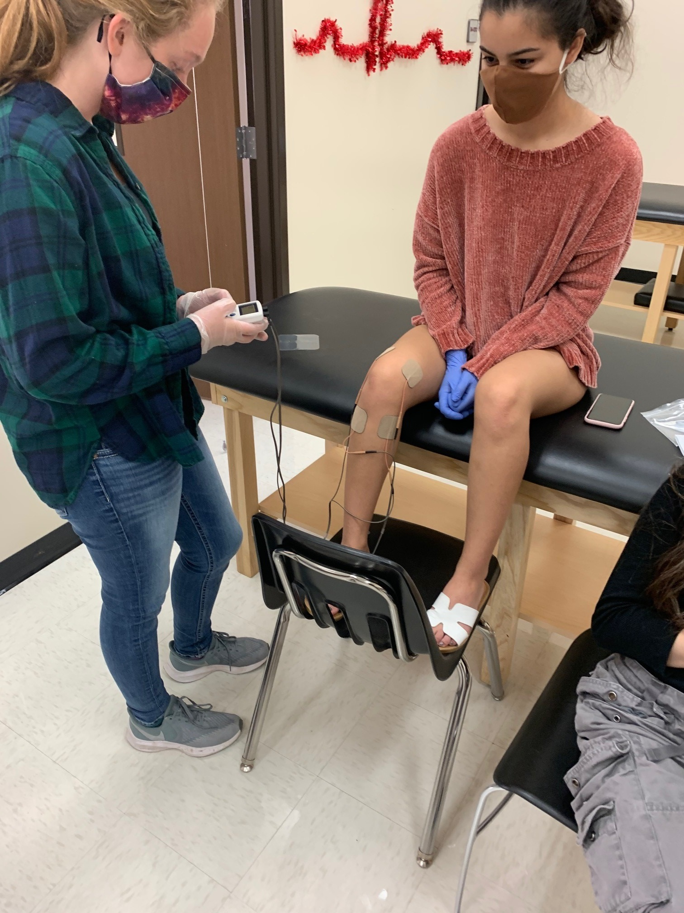
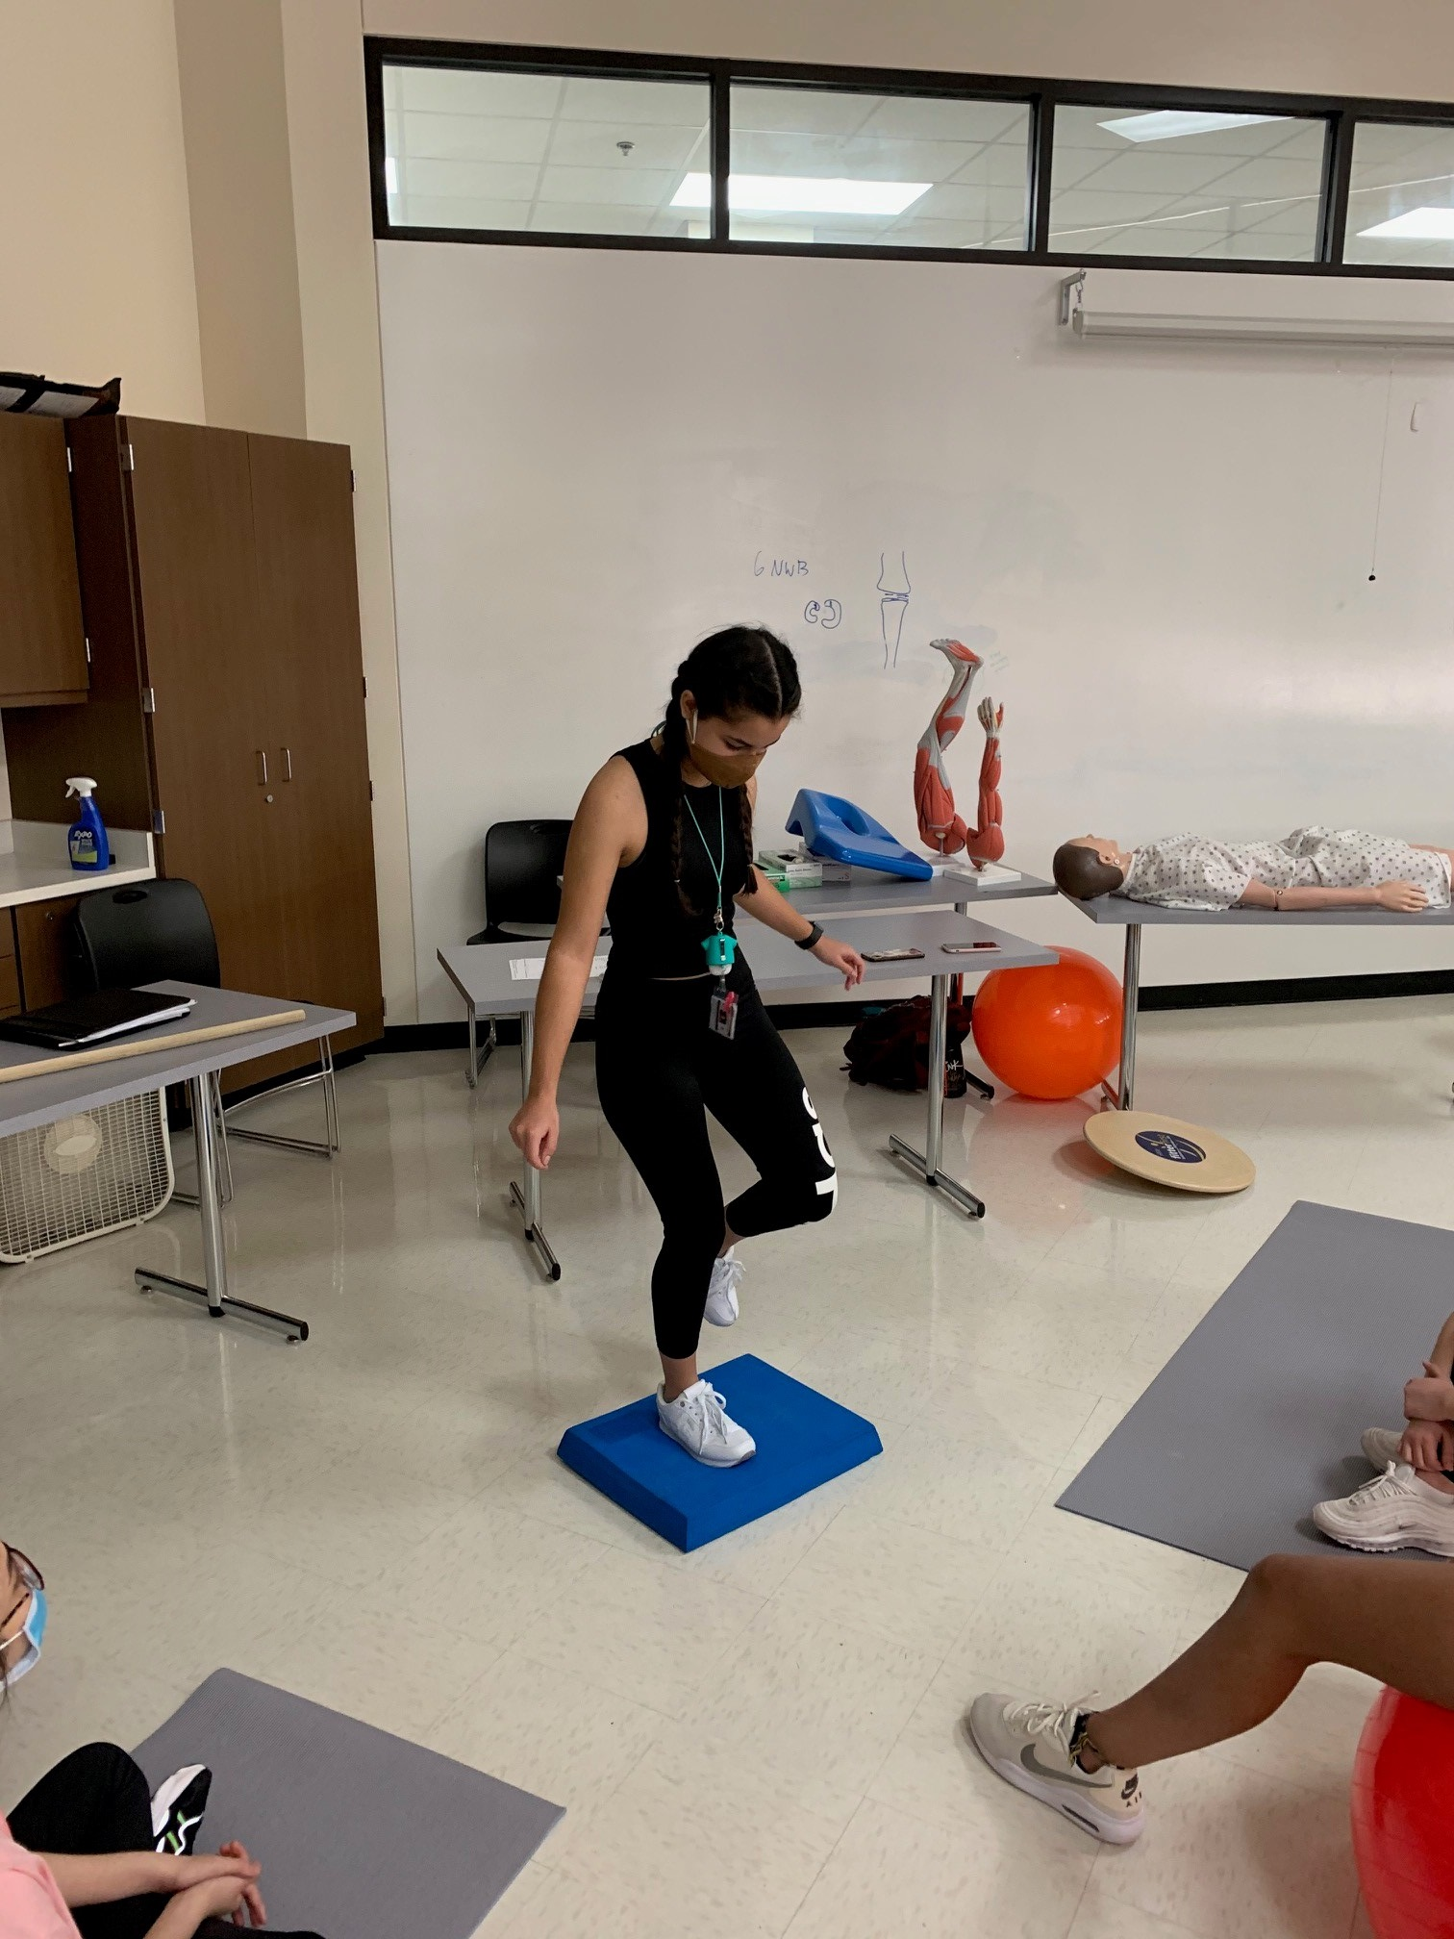
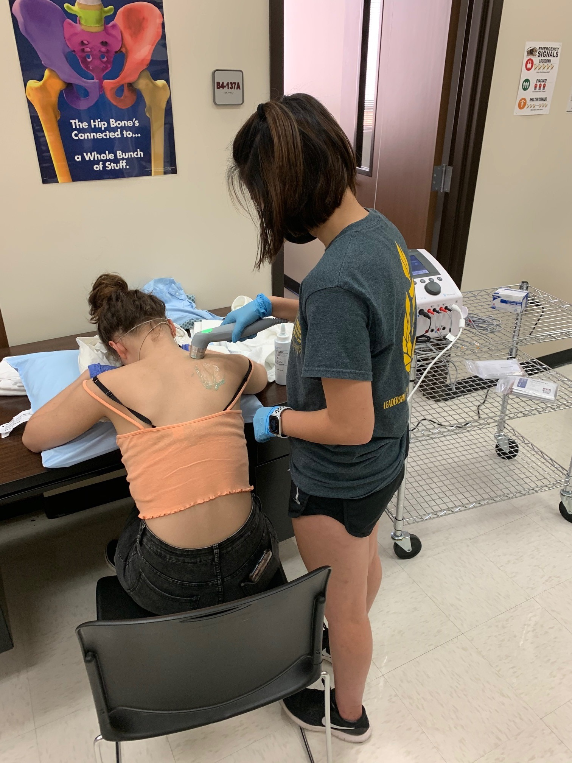
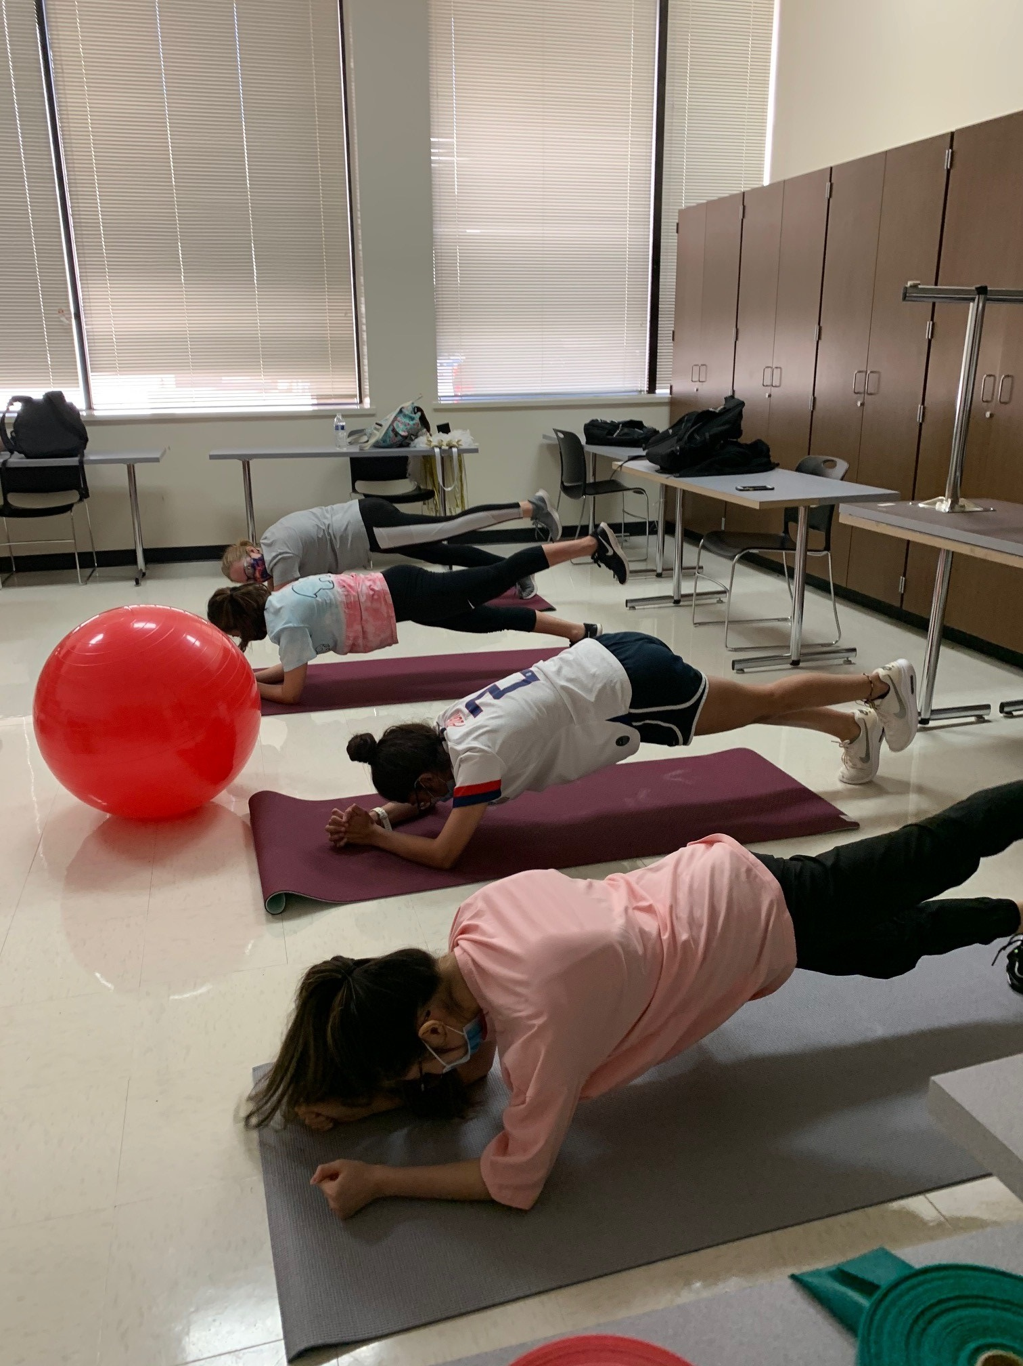
Rehabilitation Aide

Slide 18
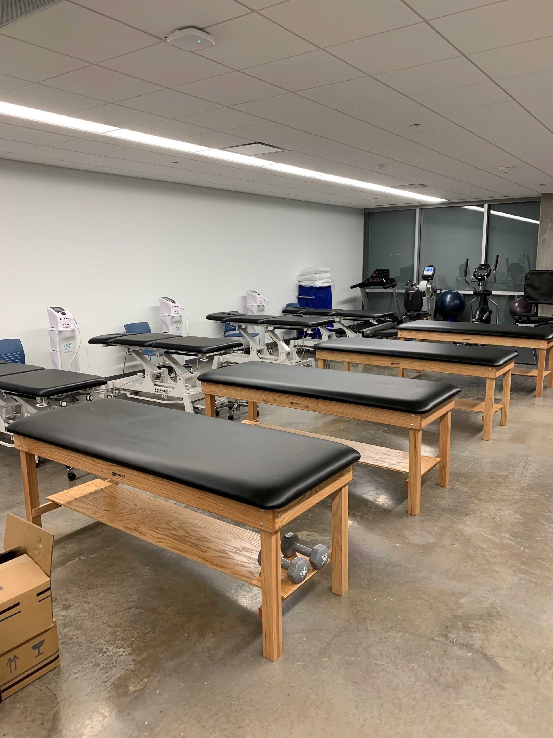
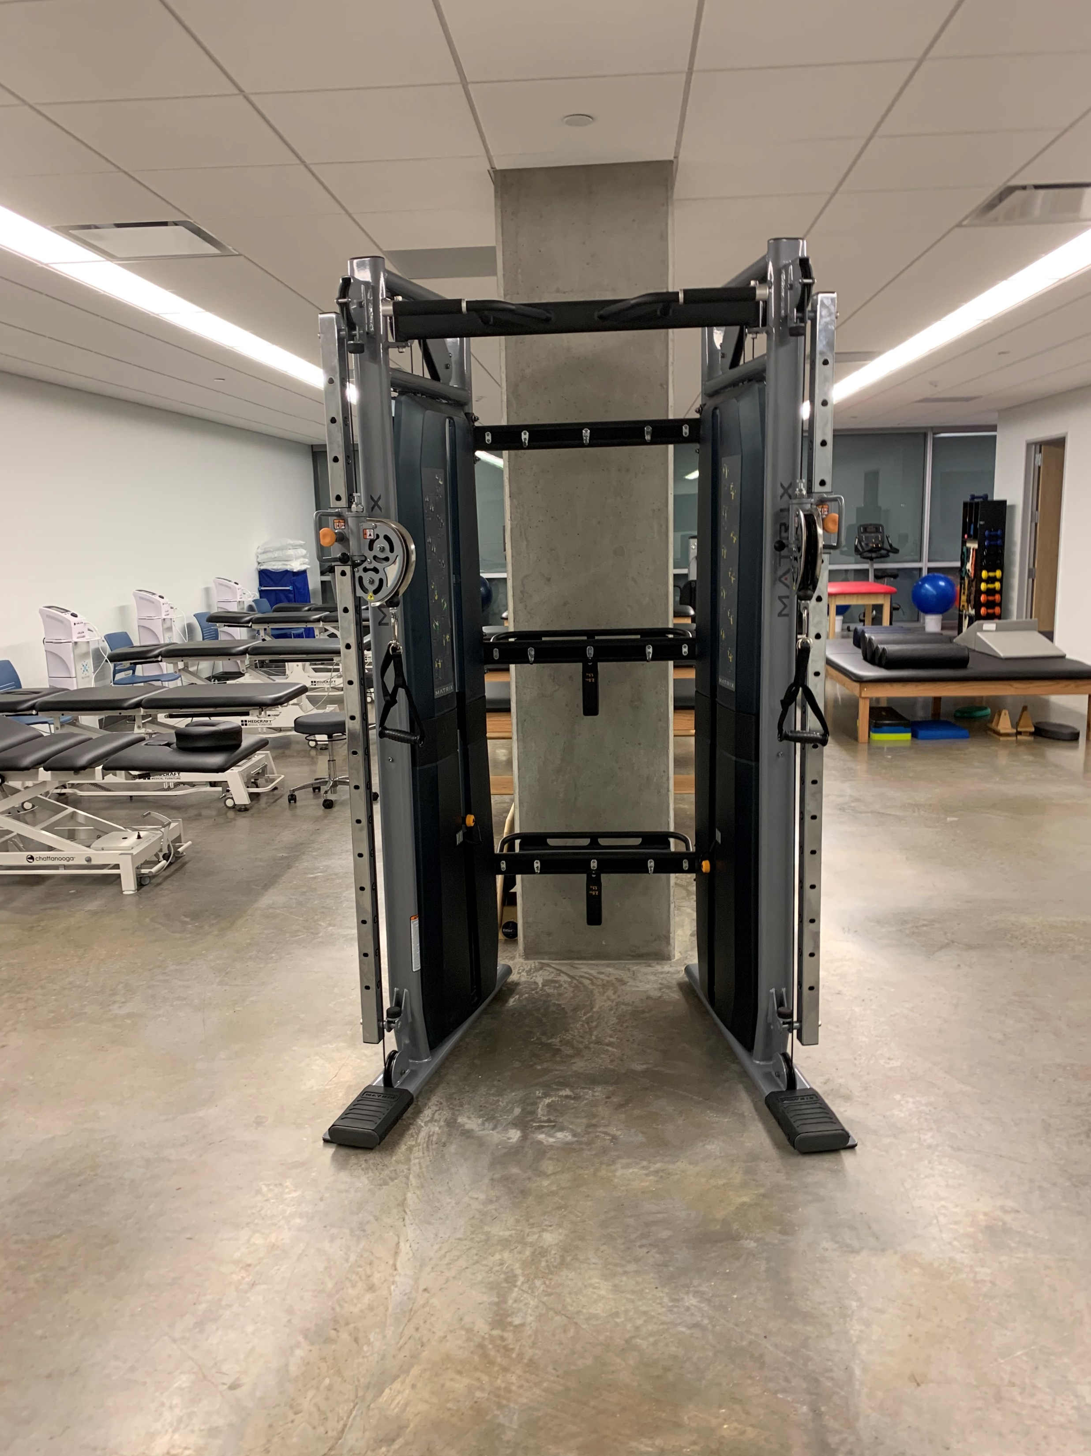
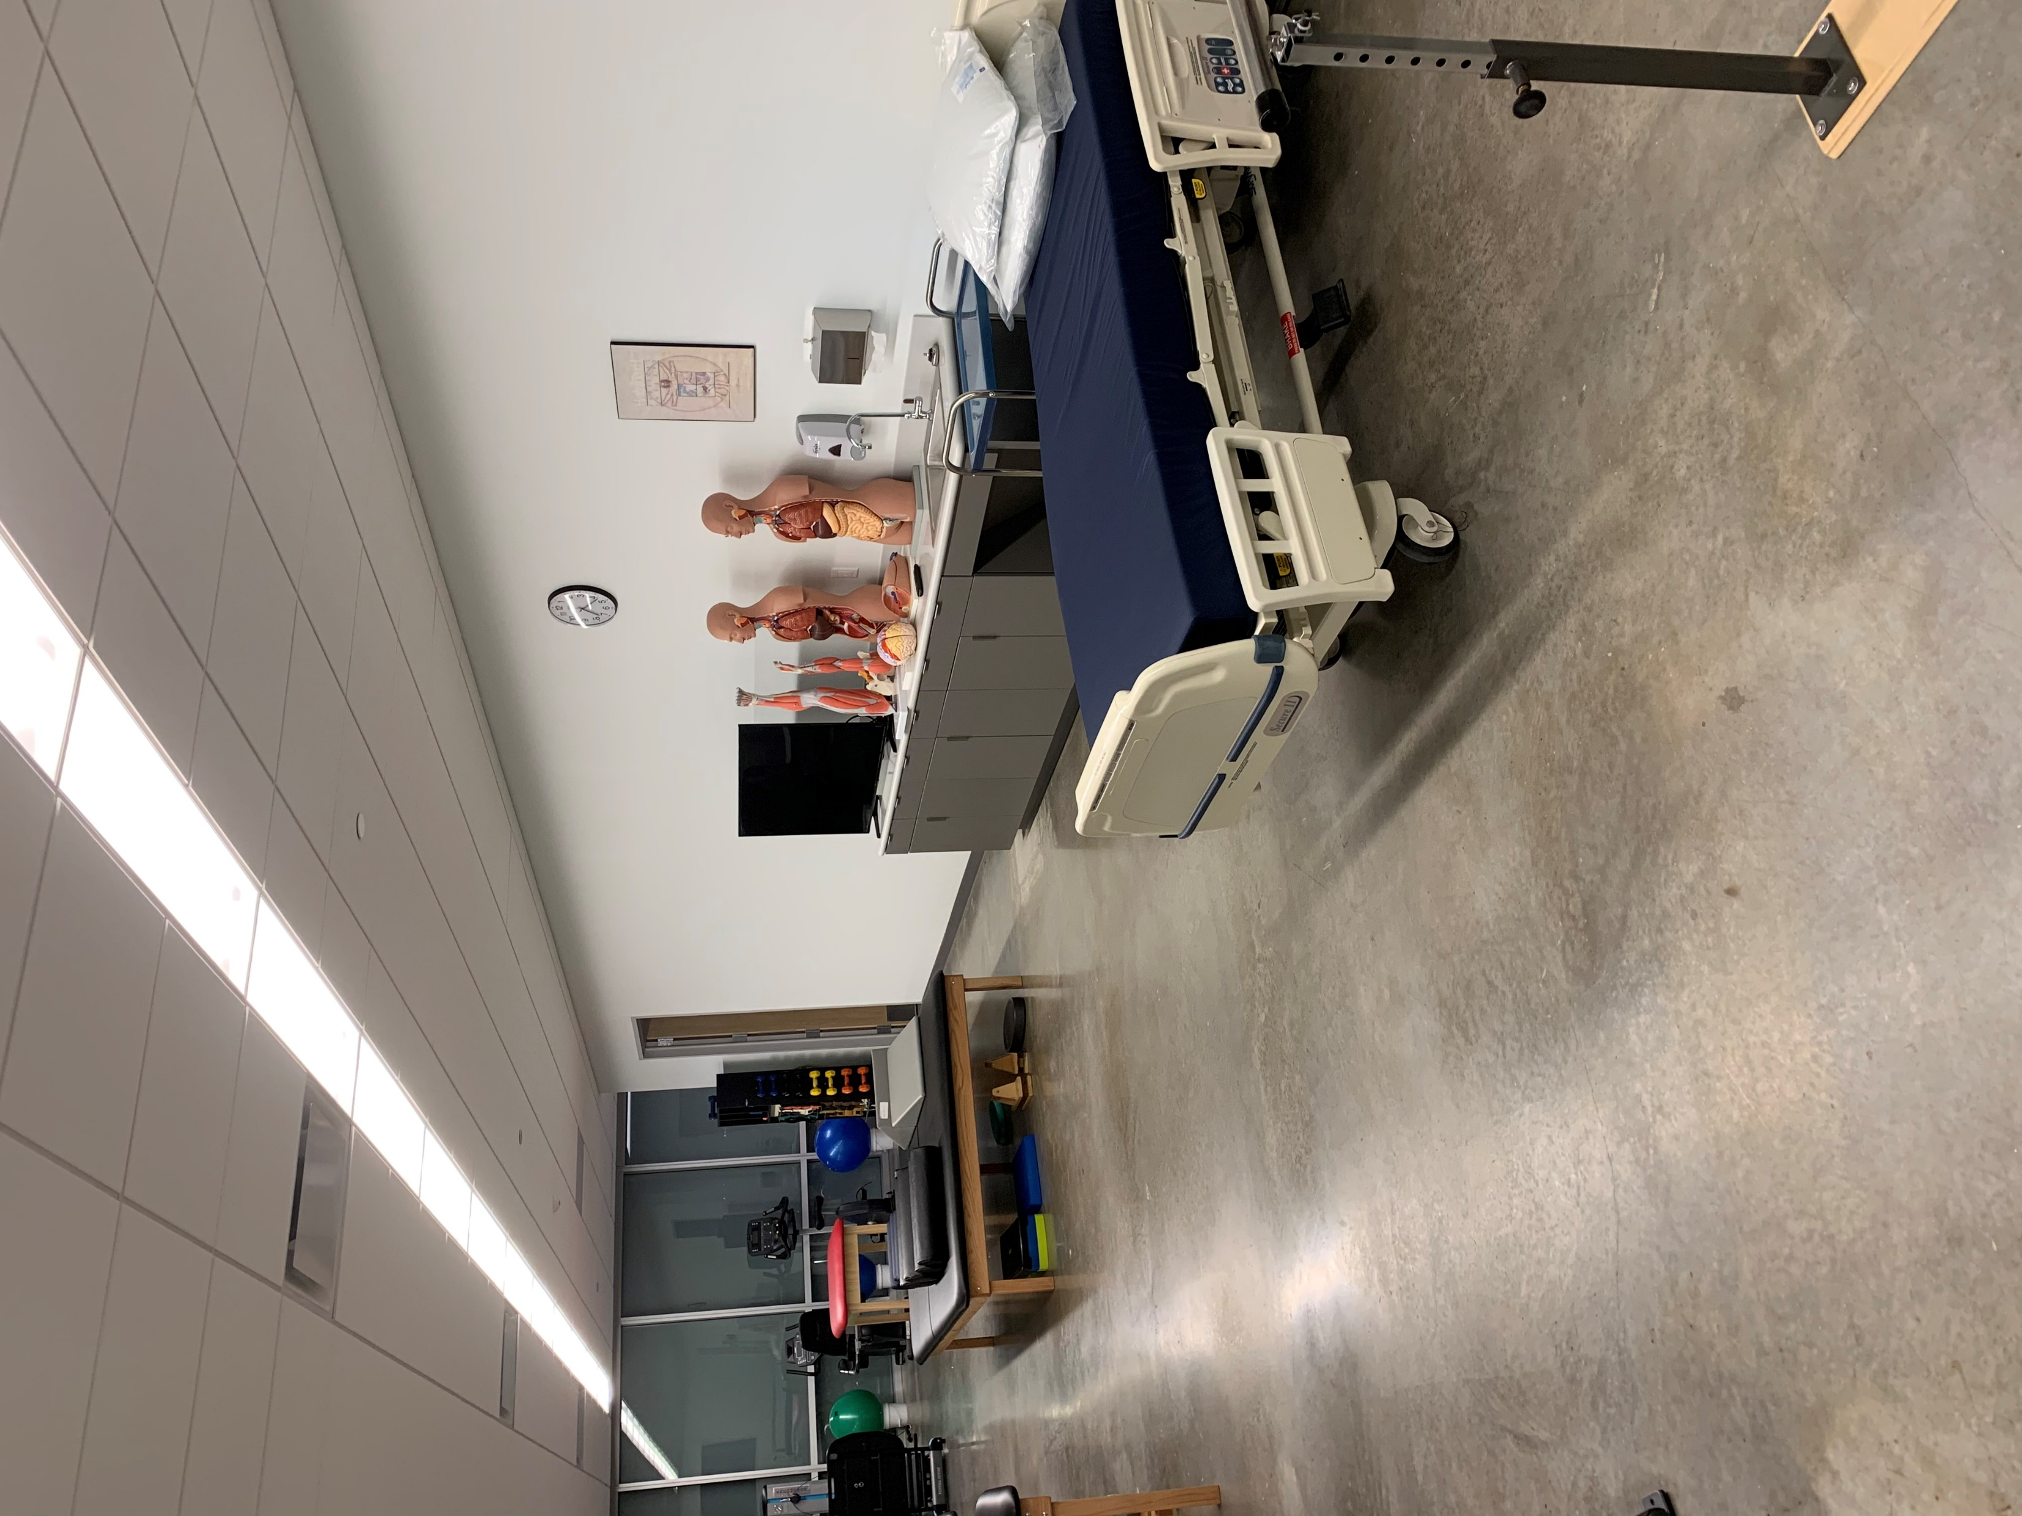
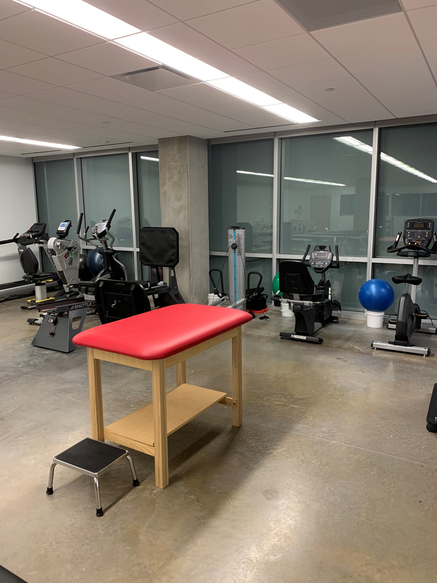
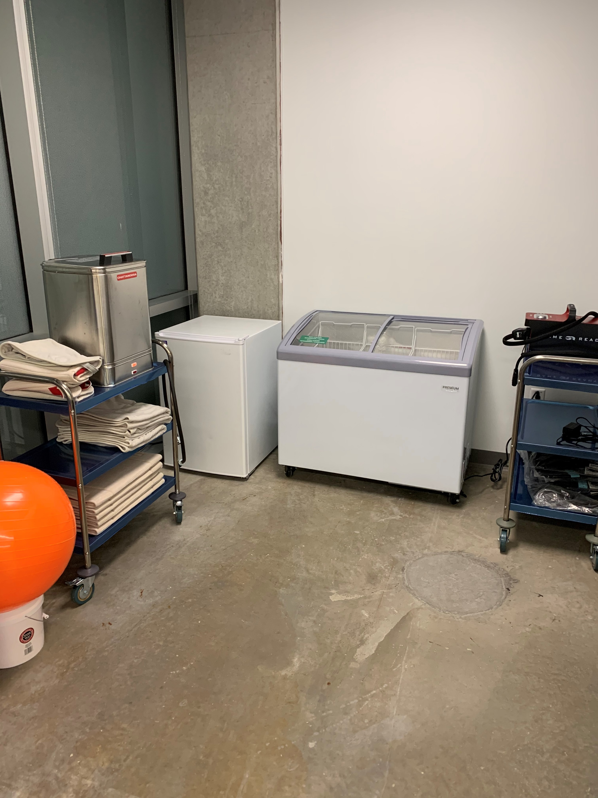
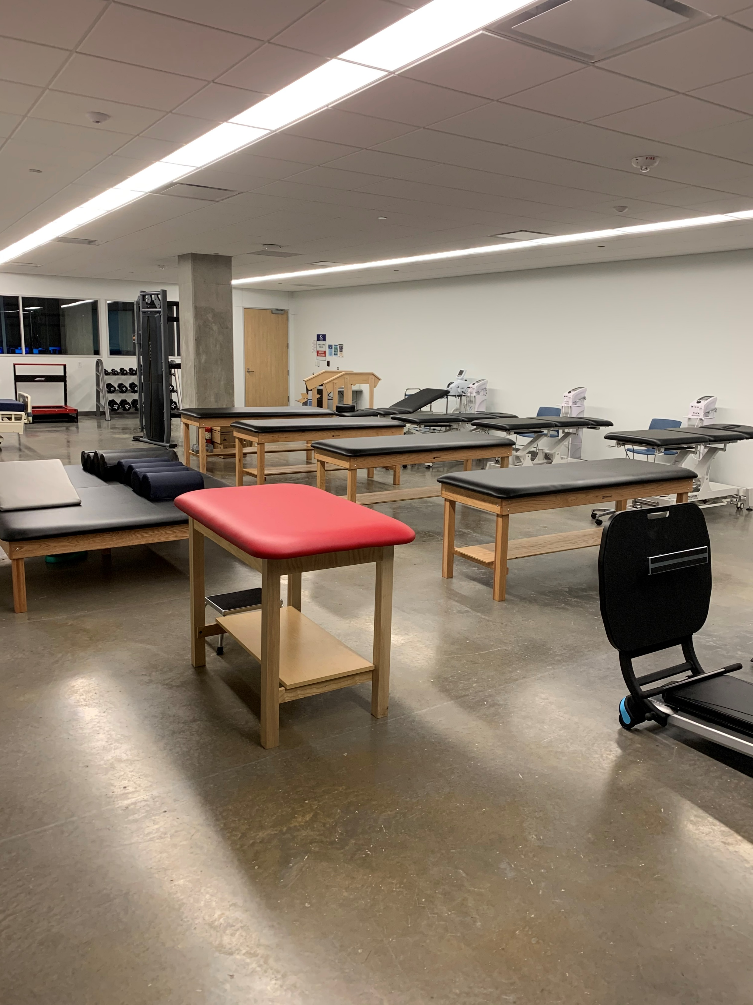
Rehabilitation Aide

Slide 19
Certification Examination
Rehabilitation Aide
Eligible to take after completing the program
Extra cost = $109

Slide 20
Estimated Program Cost
Tuition and fees | $686
Textbooks | $300
Immunization tracker | $45
Drug testing | $40
Background check | $35
Program Polo | $25
Estimated Total | $1,131
Certification Test =
$109

Slide 21
Where Do Rehabilitation Aides Work?
Hospitals
Physical Therapy Outpatient Clinics
Sports Medicine Clinics
Chiropractic Clinics
Skilled Nursing Facilities
Rehabilitation Hospitals
Nursing Homes
Etc.

Slide 22
Questions?
Certified Nurse Aide, EKG Technician, and Patient Care Technician
Dr. Juli Westcott – Program Director
jwestcott@collin.edu
214-491-6253
Emergency Medical Technician
Chief Tim Mock – Program Director
tmock@collin.edu
972-548-6530
Rehabilitation Aide
Dr. Michael Cox – Program Director
mcox@collin.edu
972-549-6319

